Slide 1
Application of Artificial Neural Network
Kevin Wu, Luya Wang

Slide 2
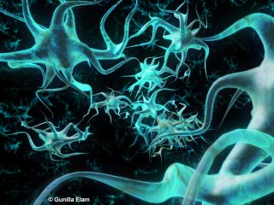
What is Artificial Neural Network (ANN)

Slide 3
Examples for application
Classification (one-layer neural network trained with perceptron learning algorithms);
Approximation (multi-layer neural network trained with back propagation learning algorithm);
Time Series Prediction (multi-layer neural network trained with back propagation learning algorithm);
Color Clusterization (Kohonen Self-Organizing Map);
Traveling Salesman Problem (Elastic Network).

Slide 4
Types of ANN
1. Supervised Learning Algorithm (given data set)
2. Unsupervised Learning Algorithm (approximation through strategy)

Slide 5
Back Propagation Learning
Multi-layer
1974
Supervised Learning Algorithm
Approximation, prediction, object recognition, etc.

Slide 6
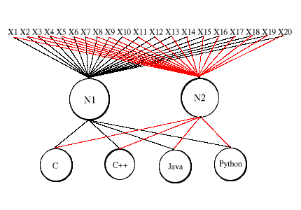
How does the network function?
For example, a programing using BP network is
trained to identify the language of a piece of code.
X1 to X20 are the words in the code.

Slide 7
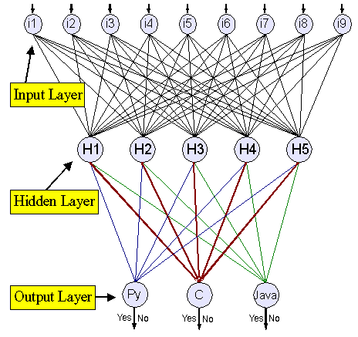
Self Adjustment
By using a set of data to train the network,
the weights between each layers will be gradually
adjusted to approximate the optimal state.

Slide 8
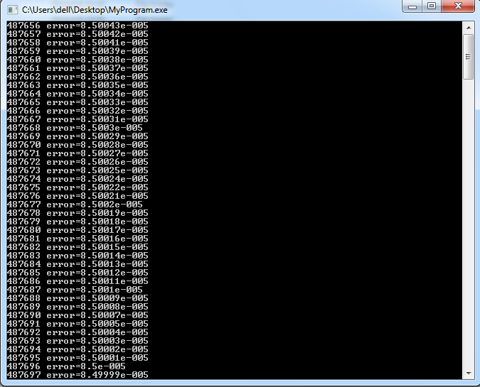
Finding Determinant through BP network
Training Section:

Slide 9
Application
Letter Recognition Program:
1. Pull features from different letters
2. Modify the features and translate them into numbers between 0 and 1 (Normalization)
3. Use the BP network training program to adjust the network so that next time it will automatically recognize the letter

Slide 10
Reference
http://www.codeproject.com/Articles/16447/Neural-Networks-on-C
http://www.ibm.com/developerworks/library/l-neural/

